Slide 1
Playing Atari with Deep Reinforcement Learning
Volodymyr Mnih, David Silver
Google DeepMind

Slide 2
Outline
1
Motivation
2
Reinforcement Learning
3
Deep Q-Network (DQN)
4
Experiments
Outline
5
Conclusion

Slide 3
Motivation

Slide 4
Motivation
Automatically convert unstructured information into useful, actionable knowledge.
Demis Hassabis

Slide 5
Motivation
Create an AI system that has the ability to learn for itself from experience.
Demis Hassabis

Slide 6
Motivation
Can do stuff that maybe we don’t know how to program.
Demis Hassabis

Slide 7
Motivation
In short,
Create artificial general intelligence.

Slide 8
Reinforcement Learning

Slide 9
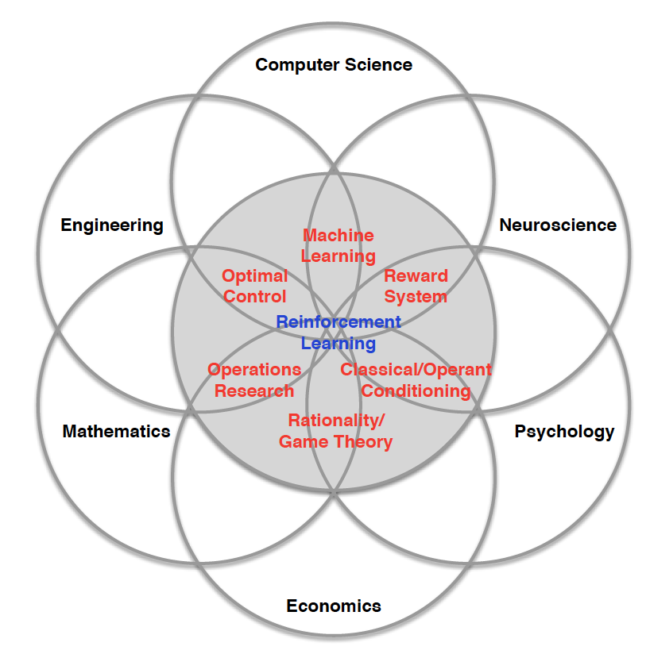
Many Faces of Reinforcement Learning
Notes:
工程： 最优控制
数学： 运筹学
经济：博弈论
心理学：工具性条件反射
神经科学：奖励系统

Slide 10
Reinforcement Learning in a Nutshell
RL is a general-purpose framework for decision-making
RL has an agent with the capacity to act
Each action influences the agent‘s future state
Success is measured by a scalar reward signal
Goal
select actions to maximize future reward
seek for a single agent which can solve any human-level task

Slide 11
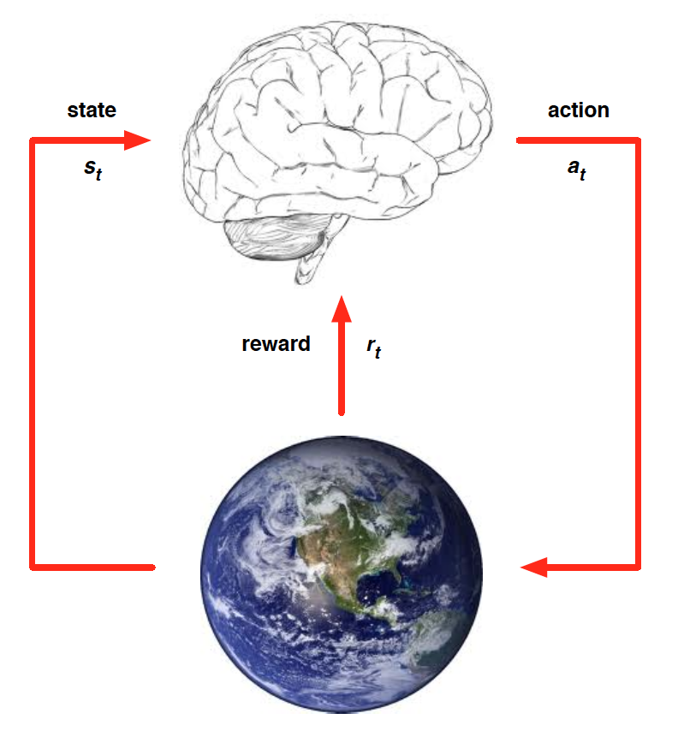
Agent and Environment
At each step t the agent:
Receive state s_{t}
Receive scalar reward r_{t}
Execute action a_{t}
The environment:
Receives action a_{t}
Emits state s_{t+1}
Emits scalar reward r_{t+1}

Slide 12
Examples of RL
Control physical systems: walk, fly, drive, swim, …
Interact with users: retain customers, personalized channel, optimize user experience, …
Solve logistical problems: scheduling, bandwidth allocation, elevator control, cognitive radio, power optimization, …
Play games: chess, Go, Atari games, …

Slide 13
Major Components of An RL Agent
An RL agent may include one or more of these components:
Policy: agent's behaviour function
Value function: how good is each state and/or action
Model: agent's representation of the environment

Slide 14

Policy
Policy $π$is the agent‘s behaviour function selecting actions given state.
It is a map from state to action:
a = $π$(s)

Slide 15
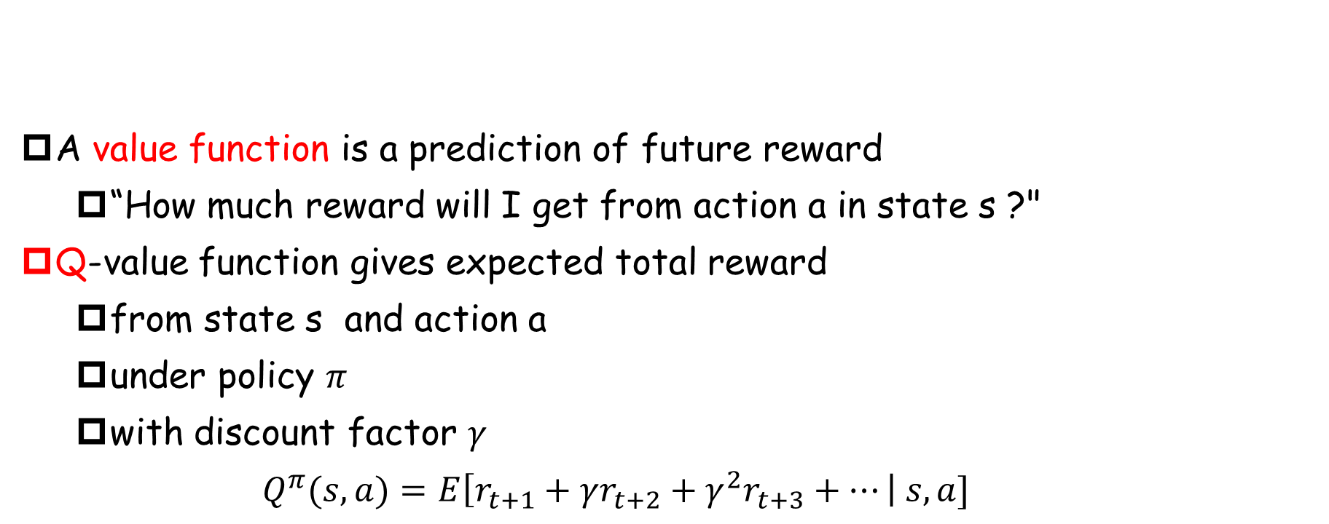
Value Function
A value function is a prediction of future reward
“How much reward will I get from action a in state s ?"
Q-value function gives expected total reward
from state s and action a
under policy $π$
with discount factor $γ$
$$Q^{π}(s,a)=E\left[r_{t+1}+γr_{t+2}+γ^{2}r_{t+3}+…\right| s,a]$$
Notes:
举例：股票投资

Slide 16
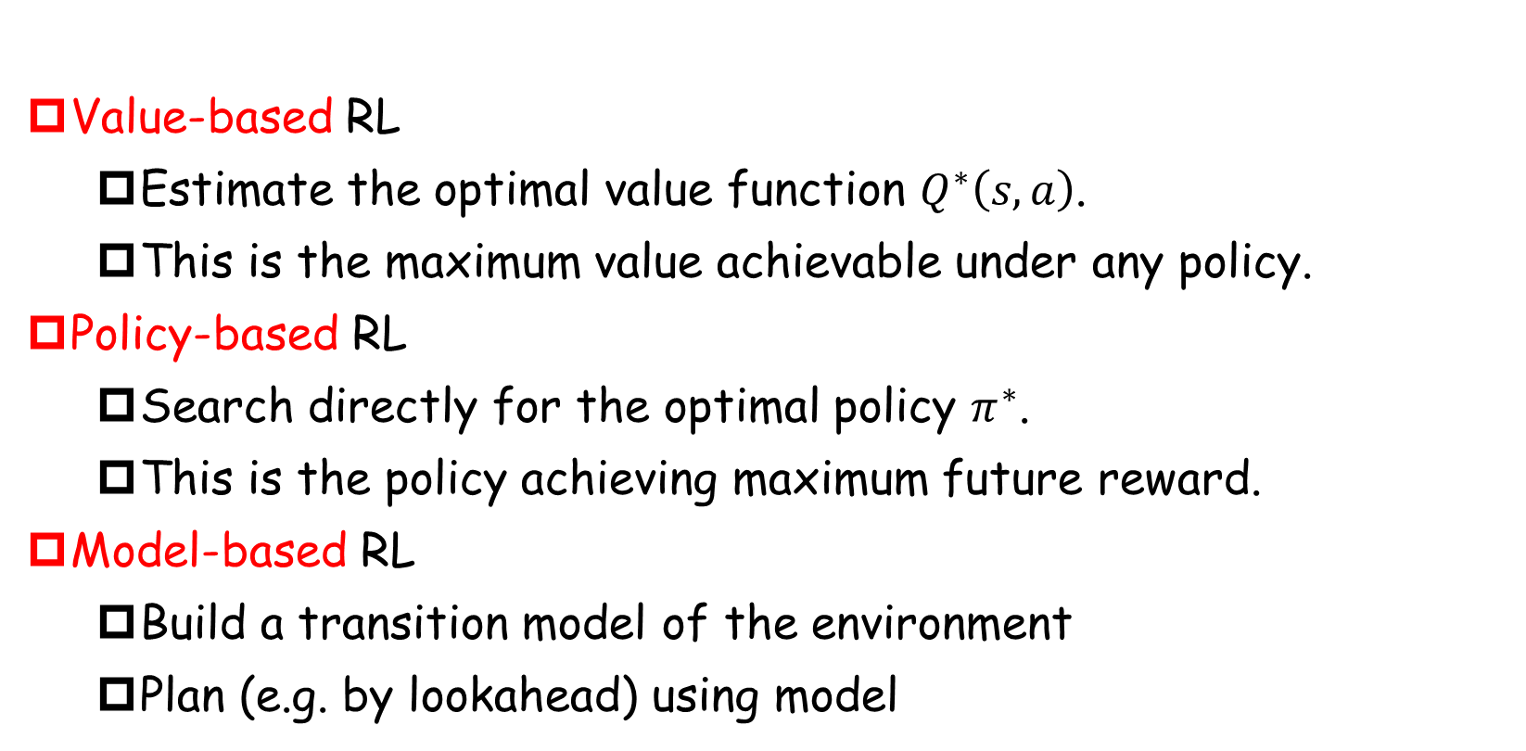
Approaches To RL
Value-based RL
Estimate the optimal value function $Q^{∗}\left(s,a\right)$.
This is the maximum value achievable under any policy.
Policy-based RL
Search directly for the optimal policy $π^{∗}$.
This is the policy achieving maximum future reward.
Model-based RL
Build a transition model of the environment
Plan (e.g. by lookahead) using model

Slide 17
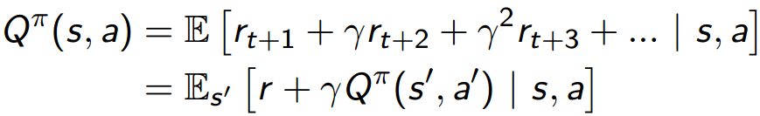
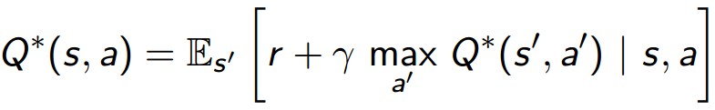
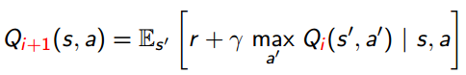

Bellman Equation
Value function can be unrolled recursively
Optimal value function $Q^{∗}\left(s,a\right)$ can be unrolled recursively
Value iteration algorithms solve the Bellman equation

Slide 18
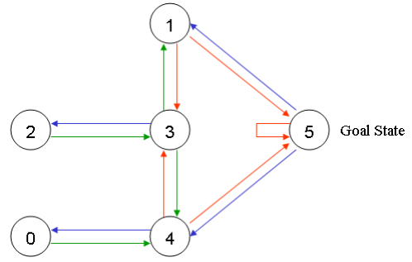
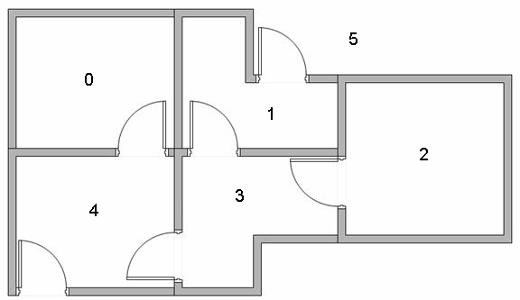
An Example of Q-learning
Suppose we have a house with 5 rooms.
Starting from any room.
Destination: 5

Slide 19
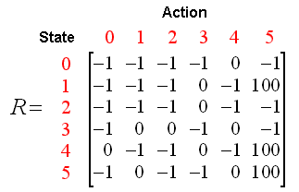
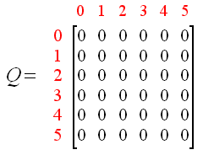
An Example of Q-learning
On-step reward matrix R (fixed)
State + Action → Reward
Q-matrix (changing)

Slide 20
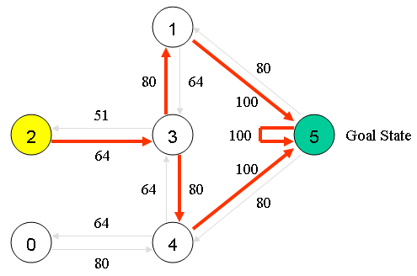
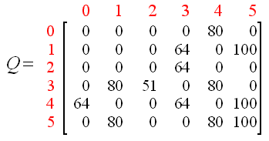
An Example of Q-learning
Goal is Q-matrix
At ant state, Q-matrix tells us the optimal next state.

Slide 21
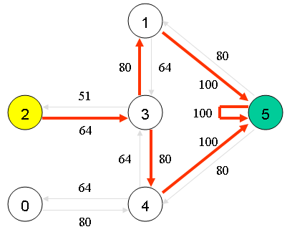
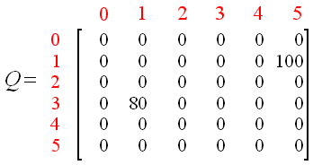
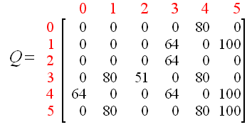
An Example of Q-learning
Calculate Q-matrix:
Q(s, a) = R(s, a) + gamma*max[Q(s’, a’)]
Randomly pick a state: 1; next state: 3, 5; pick 5 as the next state
Q(1, 5) = R(1, 5) + 0.8*max[Q(5, 1), Q(5, 4), Q(5, 5)] = 100+0.8*0 = 100
Randomly pick a state: 3; next state: 1, 2, 4; pick 1 as the next state
Q(3, 1) = R(3, 1) + 0.8*max[Q(1, 3), Q(1, 5)] = 0+0.8*max(0, 100) = 80
Repeat until convergence.

Slide 22
Deep Q-Network (DQN)

Slide 23
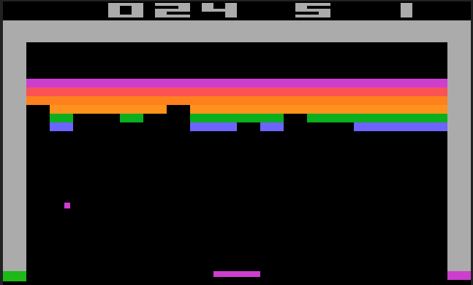
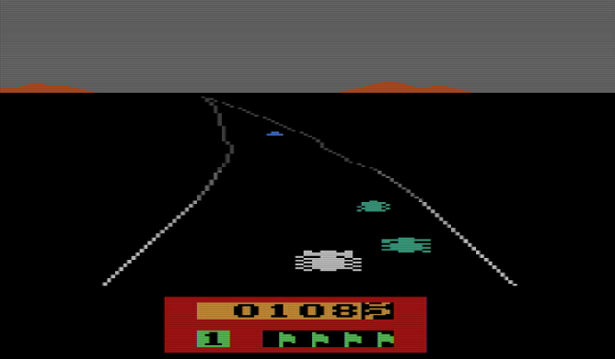
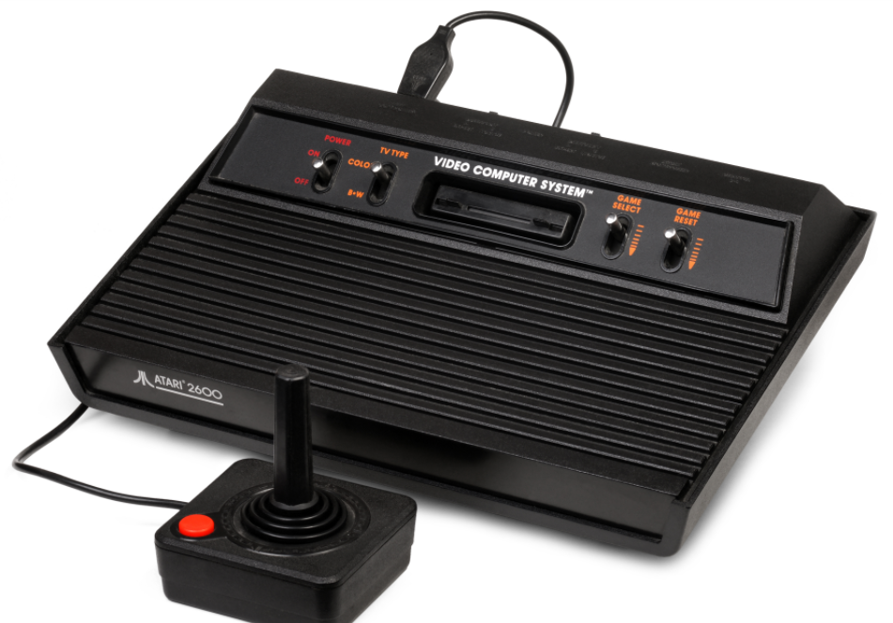
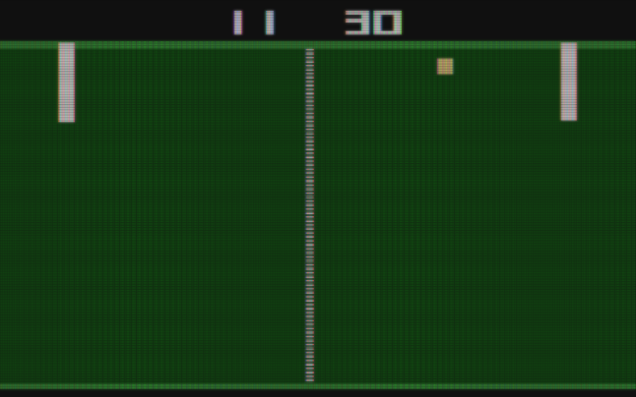
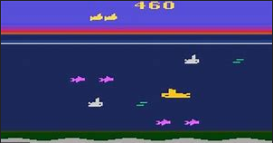
Atari 2600 Game

Slide 24
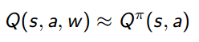
Why Q-learning Does Not Work in Atari
Cons
Q-learning is a table-based approach.
Finite state and action space.
Cannot deal with a state never seen.
No generalization ability.
Solution
Formalized as a regression problem.
Linear model + hand-crafted features.

Slide 25
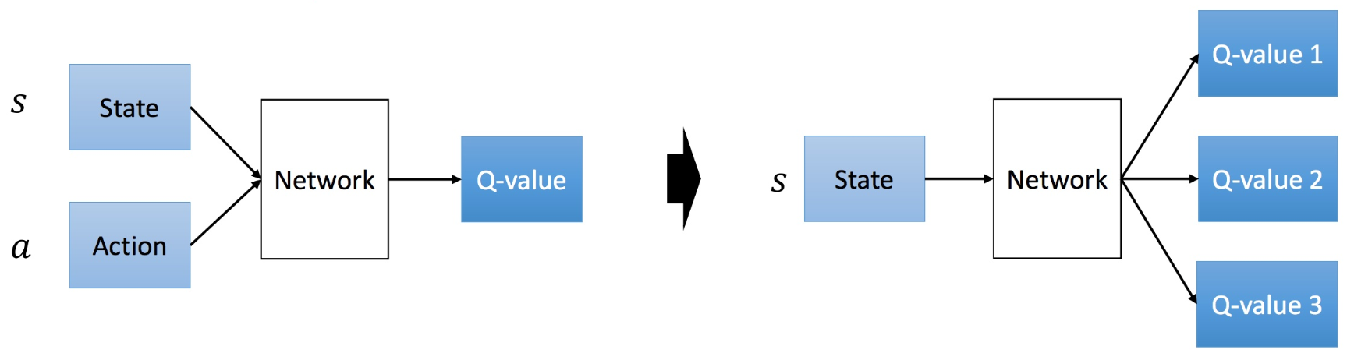
Deep Reinforcement Learning
Can we apply deep learning to RL?
Use deep network to represent value function/policy/model.
Optimize value function/policy/model end-to-end.
Using stochastic gradient descent.
Previous approaches: input state and action, output Q-value.
DQN: input state, output Q-values; reduce computation.

Slide 26
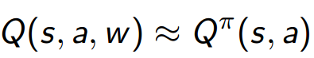
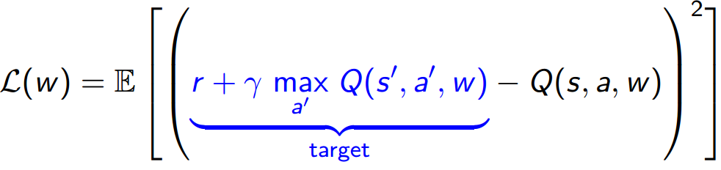
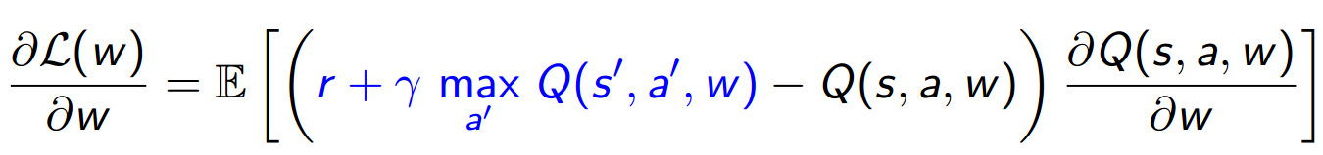
From Q-learning to Deep Q-learning
Represent value function by deep Q-network with weights w
Define objective function by mean-squared error in Q-values
Leading to the following Q-learning gradient
Optimize objective end-to-end by SGD

Slide 27
Deep Q-Network on Atari
Goal
Create a single neural network agent that is able to successfully learn to play 49 Atari 2600 arcade games.
Learn strictly from experience - no pre-training.
Data: game screen + score.
No game-specific tuning.

Slide 28
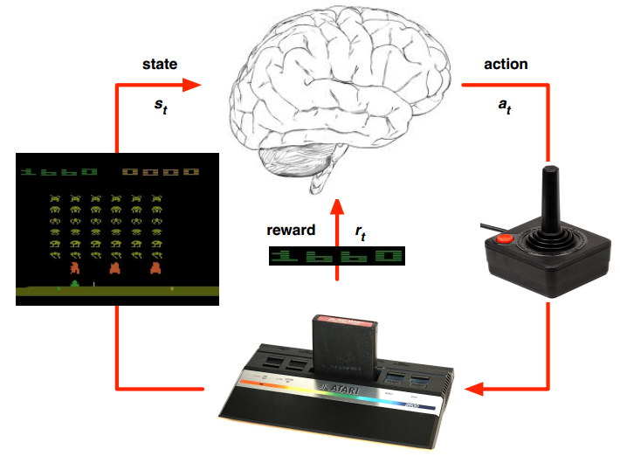
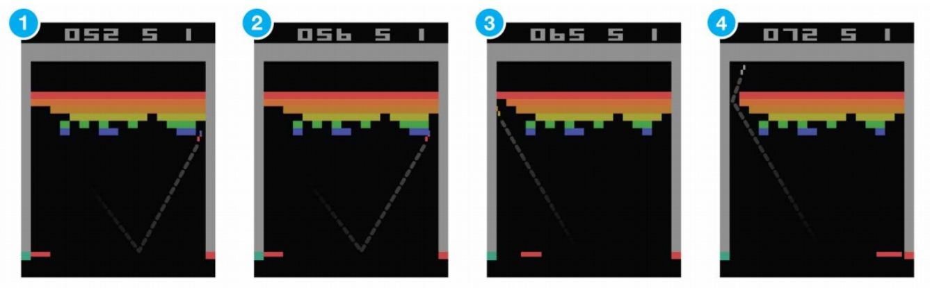
Deep Q-Network on Atari
State - each unique screenshot corresponds to one state.
210*160 pixels with 128 color palette.
Action – 18 corresponding to:
9 directions of joystick (including no input)
9 directions + button
Reward – Change of game score.

Slide 29
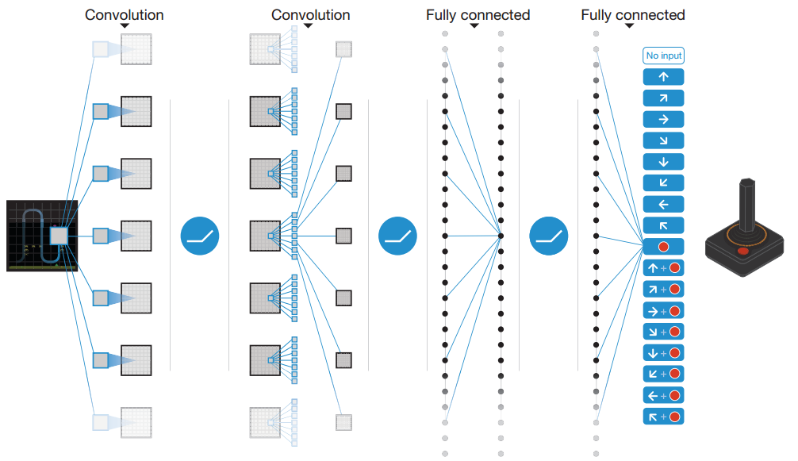
Deep Q-Network on Atari
Schematic of network
Input: 4 successive frames to capture environment dynamically
2 convolutional layers + 2 fully connected layers
Output: Q-values of 18 actions

Slide 30
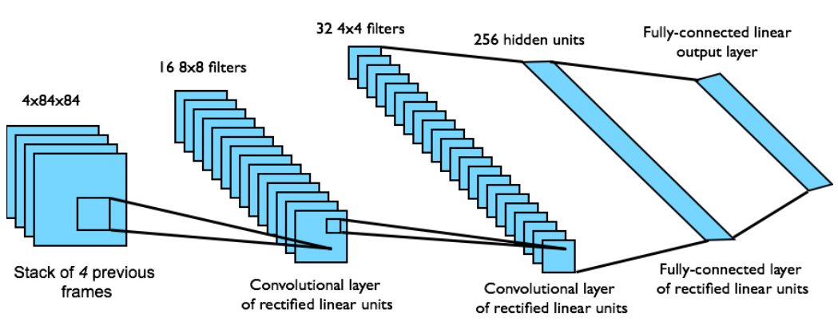
Deep Q-Network on Atari
Network structure
Network architecture and hyper-parameters fixed across all games.

Slide 31
Stability Issues with DQN
Naïve DQN oscillates or diverges with neural nets.
Data is sequential
Successive samples are highly correlated, non-iid.
Policy changes rapidly with slight changes to Q-values.
Policy may oscillate
Distribution of data can swing from one extreme to another
Scale of rewards and Q-values is unknown.
Naive DQN gradients can be large unstable when back-propagated.

Slide 32
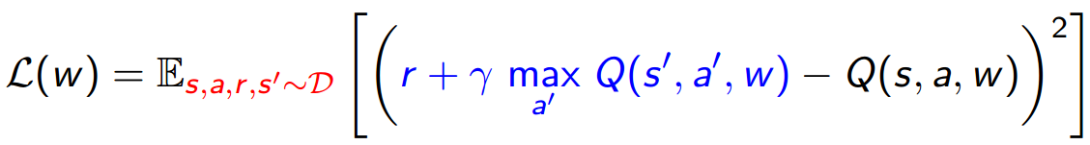
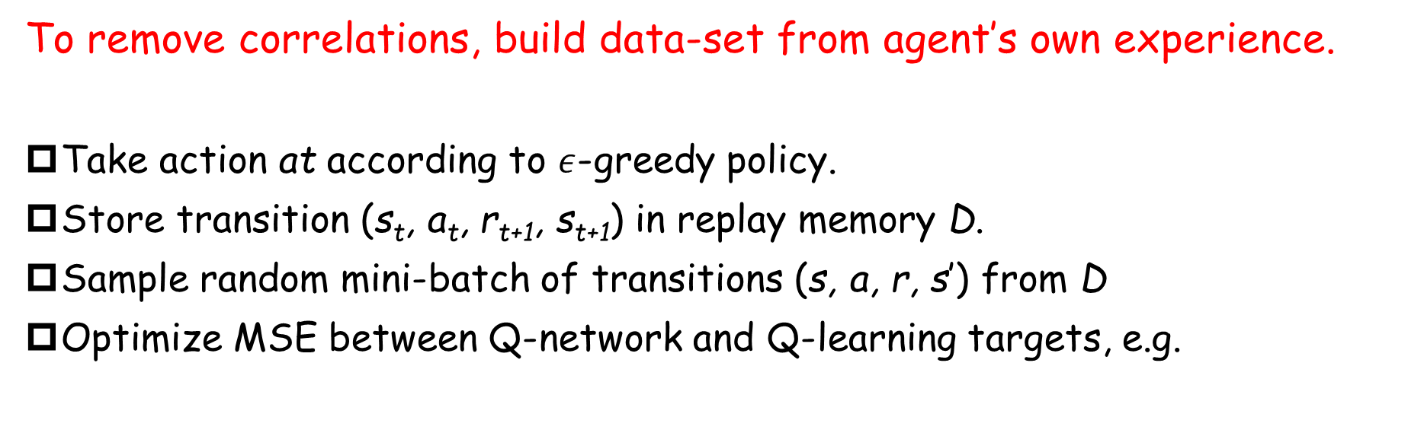
Stable Deep RL (1): Experience Replay
To remove correlations, build data-set from agent’s own experience.
Take action at according to $ε$-greedy policy.
Store transition (s_{t}, a_{t}, r_{t+1}, s_{t+1}) in replay memory D.
Sample random mini-batch of transitions (s, a, r, s’) from D
Optimize MSE between Q-network and Q-learning targets, e.g.

Slide 33
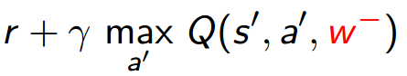
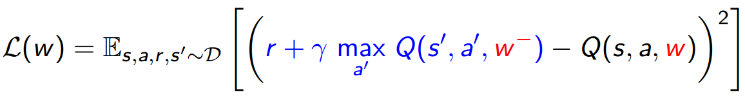
Stable Deep RL (2): Fixed Target Q-Network
To avoid oscillations, fix parameters used in Q-learning target.
Compute Q-learning targets w.r.t. old, fixed parameters w⁻.
Optimize MSE between Q-network and Q-learning targets.
Periodically update fixed parameters w⁻ ← w.

Slide 34
Stable Deep RL (3): Reward/Value Range
To resolve unstable gradient, clip rewards.
DQN clips the rewards to [-1, +1].
Positive reward → 1, negative reward → -1, 0 unchanged.
This prevents Q-values from becoming too large.
Ensures gradients are well-conditioned.
Can’t tell difference between small and large rewards.

Slide 35
Summary of DQN
DQN provides a stable solution to deep value-based RL.
Use experience replay
Break correlations in data, bring us back to iid setting.
Learn from all past policies.
Freeze target Q-network
Avoid oscillations.
Break correlations between Q-network and target.
Clip rewards or normalize network adaptively to sensible range
Robust gradients.

Slide 36
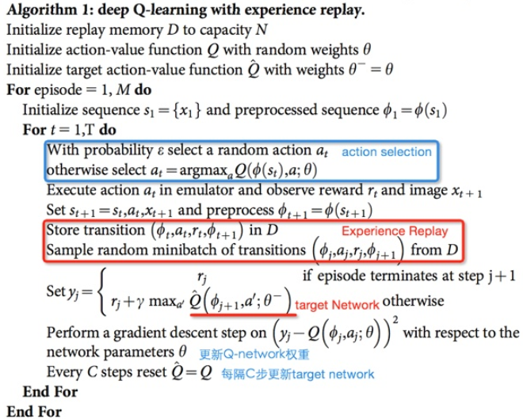
Summary of DQN

Slide 37
Experiments

Slide 38
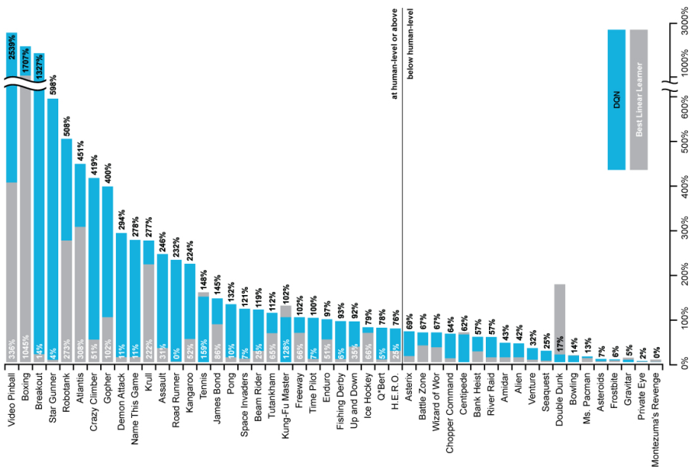
DQN Results in Atari

Slide 39
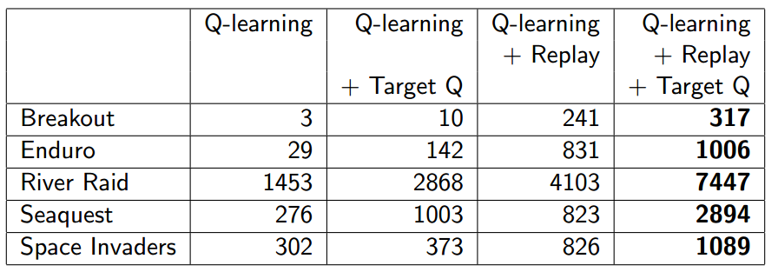
How Much Does DQN Help?

Slide 40
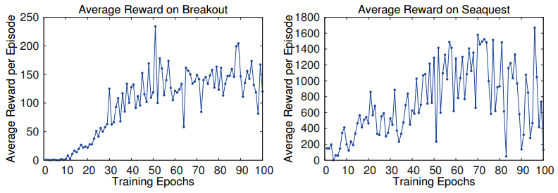
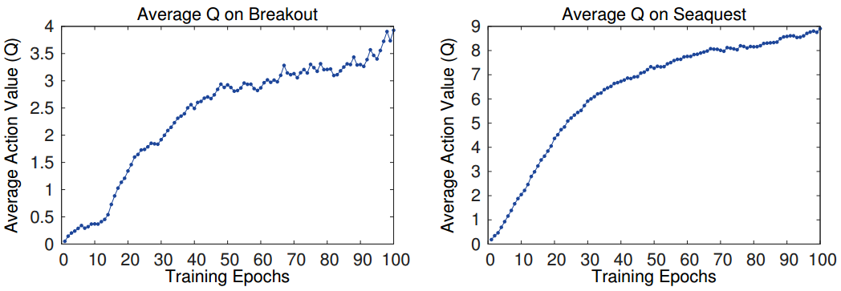
Training and Stability
Notes:
网络权重一个小的变化造成action分布较大的变化
Q值是折现的未来reward

Slide 41
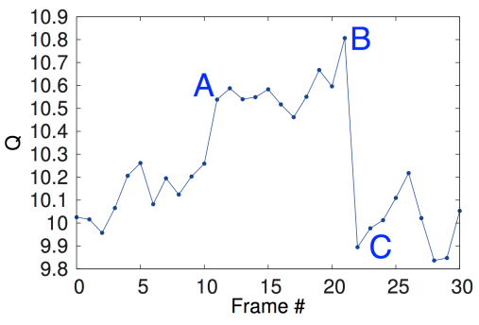
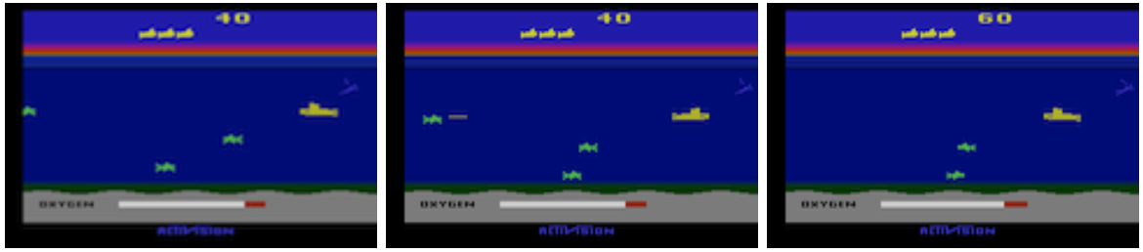
Visualization of Q-value

Slide 42
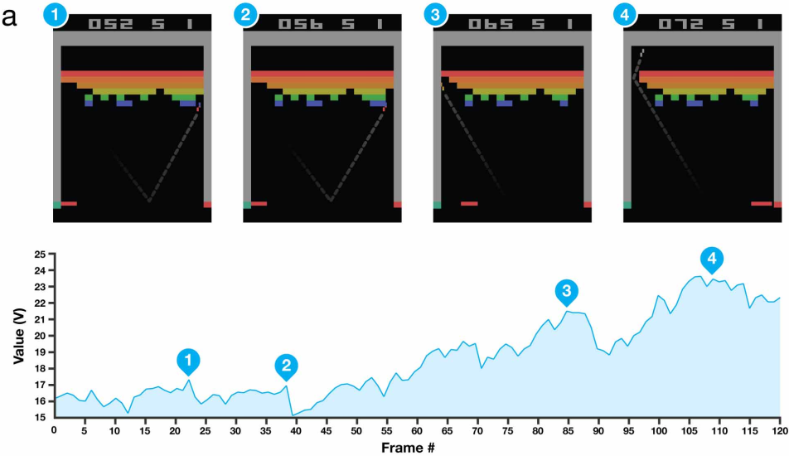
Visualization of Q-value

Slide 43
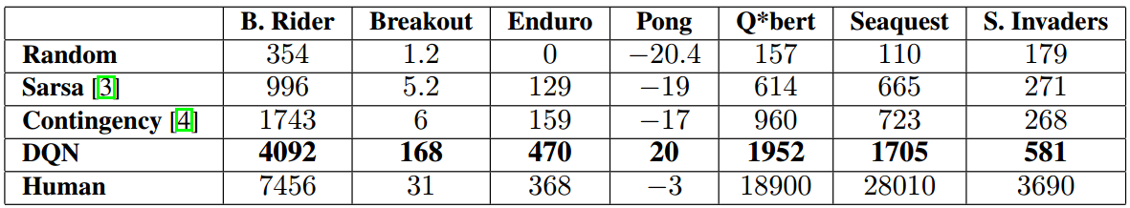

Comparison
Average total reward
Single best performance episode
Notes:
Sarsa：线性算法+人工特征
Contingency: Sarsa改进，特征增多
HNeat Best：人工设计的物体识别算法（物体种类+位置）
Hneat Pixel：8color通道，每个通道都识别物体
对随机扰动比较敏感

Slide 44
Conclusion

Slide 45
Take-Home Messages
Deep learning + reinforcement learning.
A variant of Q-learning.
Experience replay + stochastic mini-batch update.
Fixed-target Q-network.
Reward clip.
Reinforcement learning has a long way to go.

Slide 46
Thanks!

